Slide 1
Chapter 15
Chi square

Slide 2
Chi-Square
Chi-square test for goodness-of-fit
  Used with one nominal variable
  No IV or DV, just one categorical variable on which participants are sorted
Chi-square test for independence
  Used with two nominal variables
  Don’t ‘need’ to assign IV and DV, but researchers often do

Slide 3
Chi-Square Test for Independence
Determines whether two variables are independent of each other

Slide 4
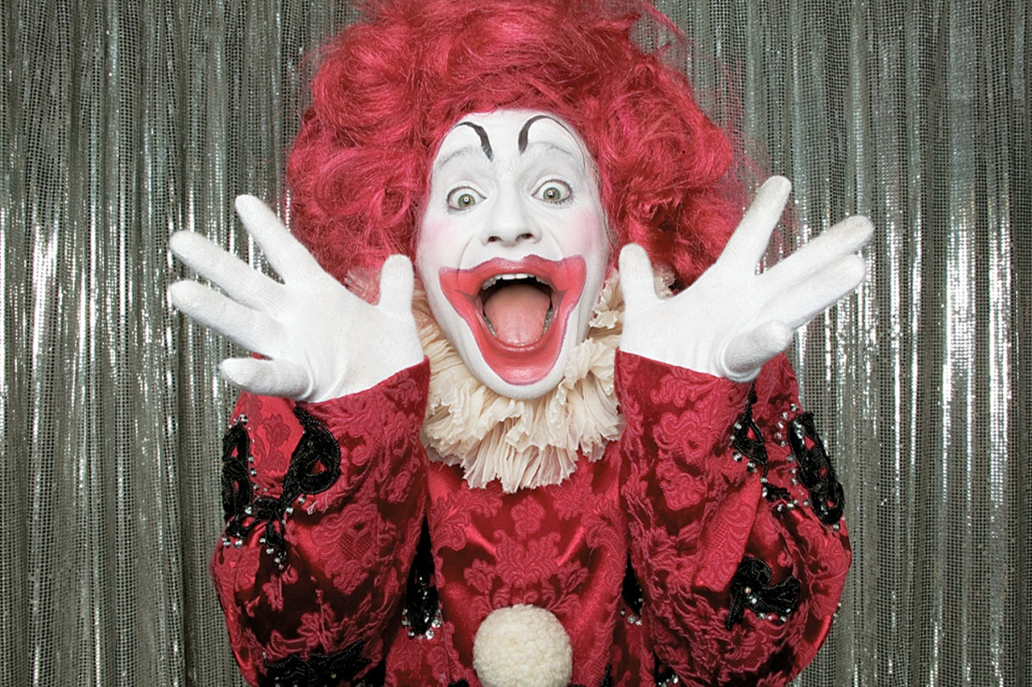
Example
Israeli physicians/researchers found that live entertainment by clowns
was associated with higher rates of conception for women receiving
IVF treatment (as reported by Ryan, 2006).

Slide 5
Example
186 women were randomly assigned to receive IVF treatment only or to receive IVF treatment followed by 15 minutes of clown entertainment
DV was defined as whether the IVF treatment was successful; that is, whether the women became pregnant

Slide 6
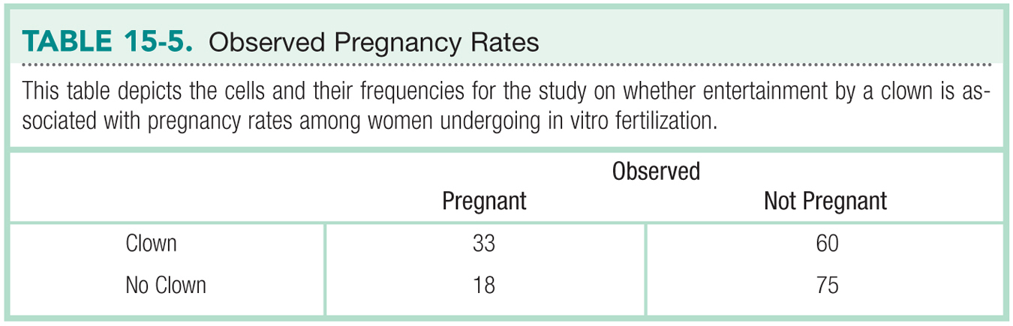
The Data

Slide 7
Step 1: Identify
Population
  Women receiving IVF treatment like the women we observed
  Women receiving IVF treatment for whom the presence of a clown is not associated with eventual pregnancy
Comparison distribution
  Chi-square
Hypothesis test
  Test for Independence
Assumptions
  Variables of interest are nominal
  Each observation is independent of all other observations
  Participants were not randomly selected
  Minimum expected frequency in each cell >5

Slide 8
Step 2: H₀ & H₁
Null Hypothesis
  Pregnancy rates are independent of whether one is entertained by a clown after IVF treatment
Research Hypothesis
  Pregnancy rates depend on whether one is entertained by a clown after IVF treatment

Slide 9
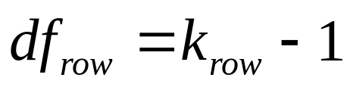


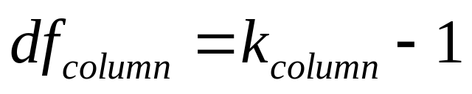
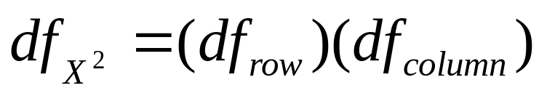
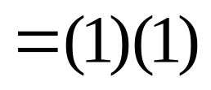
Step 3: Identify the Sampling Distribution
Calculate df for each variable, then multiply together for total df

Slide 10
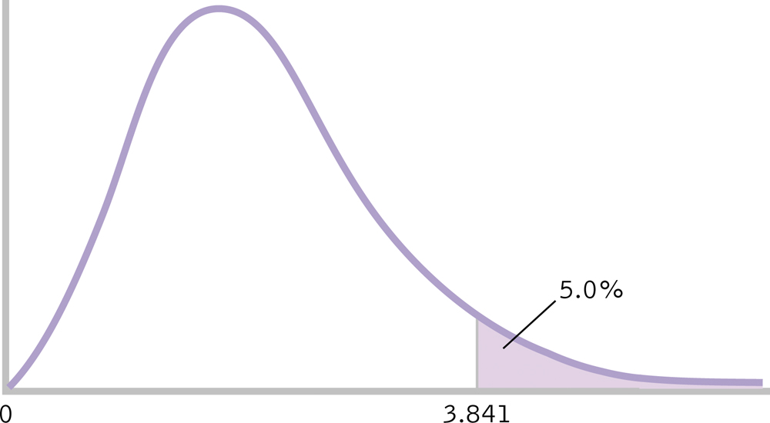
Step 4: Determine Critical Value
Critical X² = 3.841

Slide 11
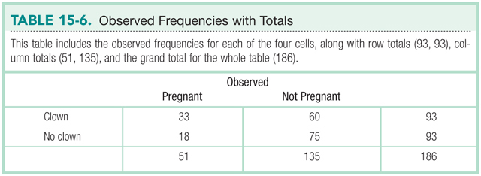
Step 5: Calculate X²

Slide 12
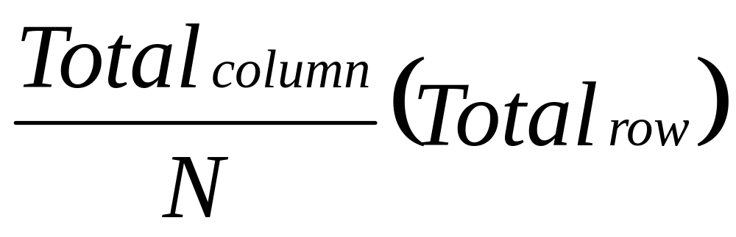
Calculate X²
Calculate expected frequencies

Slide 13
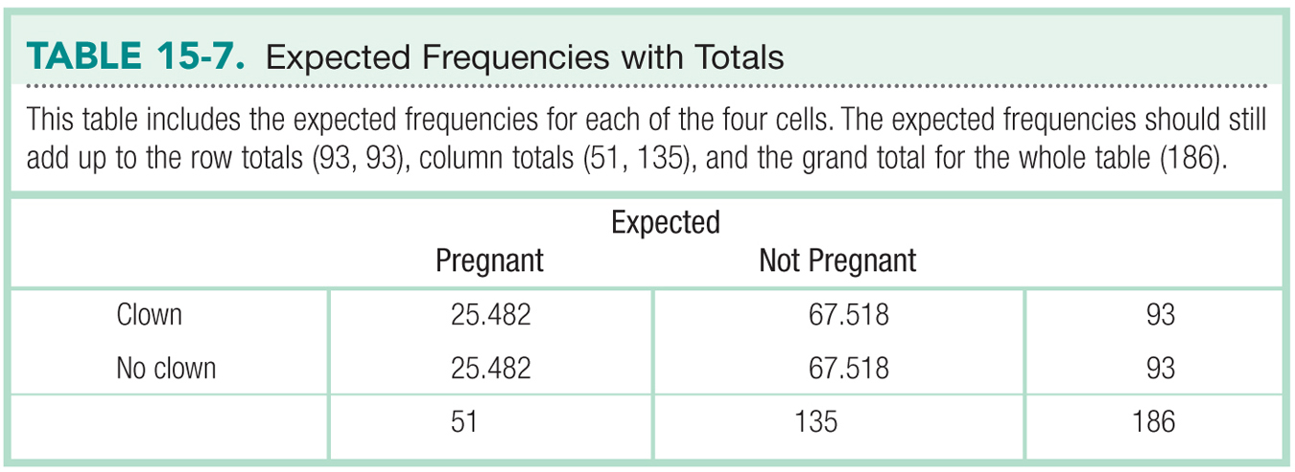
Calculate X²

Slide 14
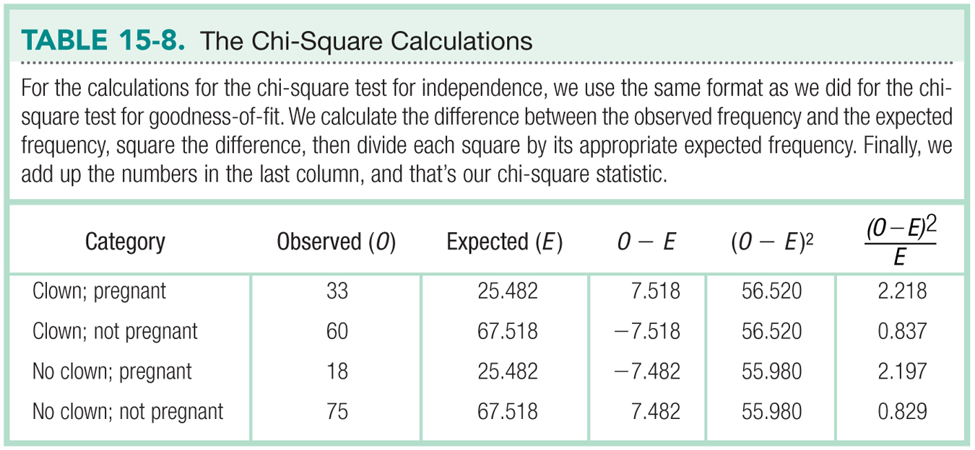
Calculate X²

Slide 15
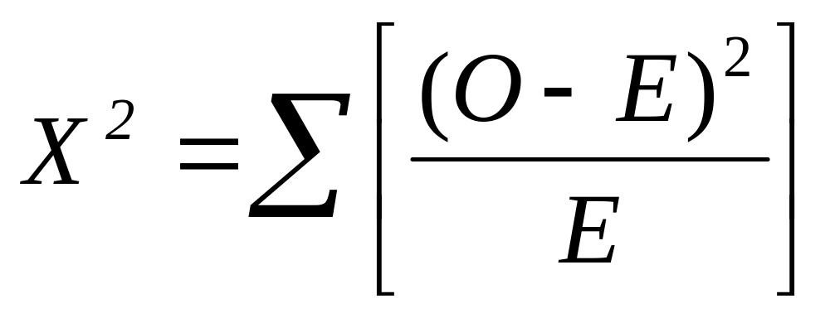
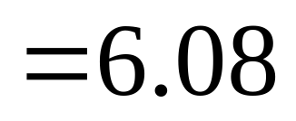
Step 5: Calculate x²

Slide 16
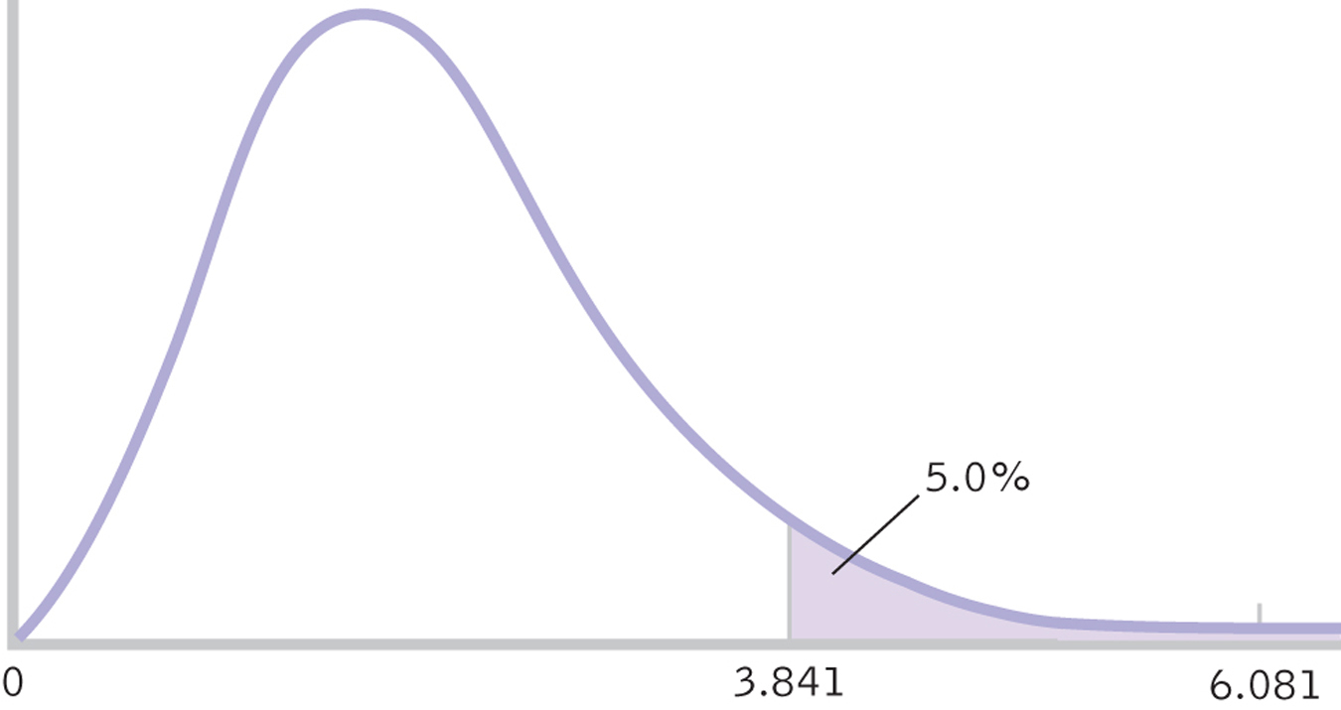
Step 6: Make a Decision

Slide 17
Step 6: Make a Decision
Reject H₀
Pregnancy rates depend on whether a woman receives clown entertainment following IVF treatment. Women who are entertained by a clown are more likely to become pregnant, X²(1, N = 186) = 6.08, p < .05.

Slide 18
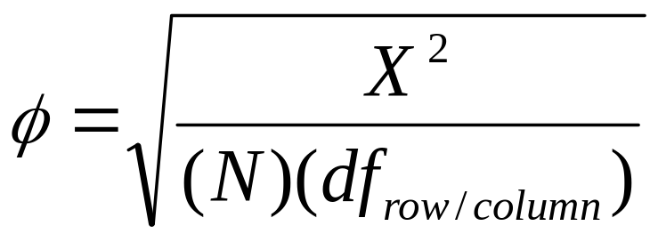
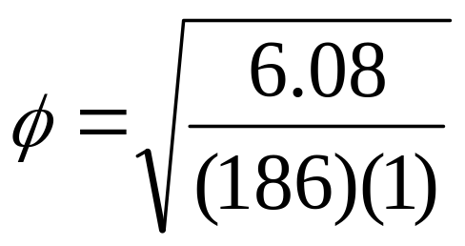
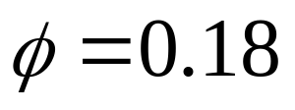
Effect Size
Cramer’s V (aka Cramer’s phi)
  Effect size measure used with chi-square test for independence

Slide 19
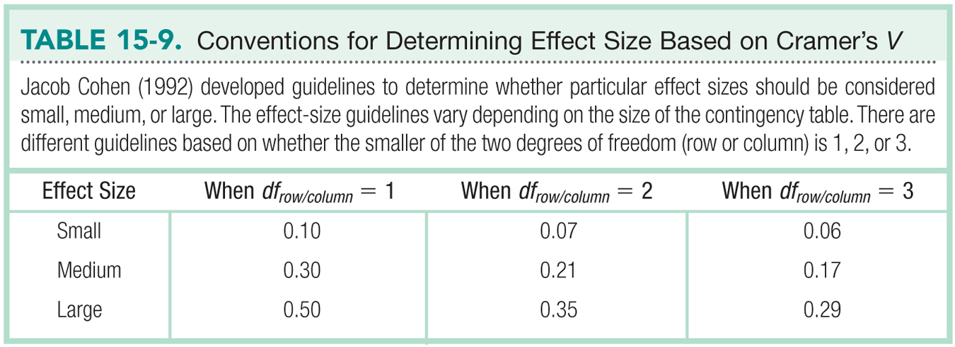
Guidelines for Cramer’s V

